Slide 1
Lecture 05
Sorting Algorithms

Slide 2
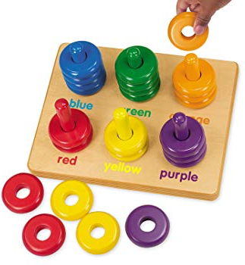
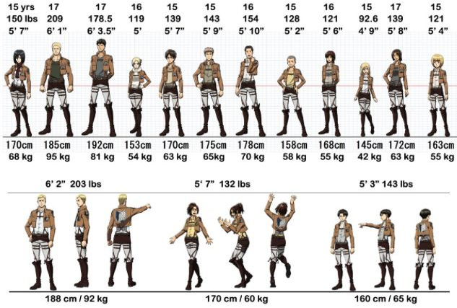

Sorting

Slide 3
Introduction to Sorting Algorithms
Sort: arrange values into an order:
Alphabetical
Ascending numeric
Descending numeric
Two basic algorithms considered here:
Bubble sort
Selection sort

Slide 4
Selection Sort: Example
Array numlist contains:
Smallest element is 2. Exchange 2 with element in 1st position (0th index) in array:
11 | 2 | 29 | 3
11 | 2 | 29 | 3
2 | 11 | 29 | 3

Slide 5
Example Contd.
Next smallest element is 3. Exchange 3 with element in 2nd position in array:
Next smallest element is 11. Exchange 11 with element in 3rd position in array:
2 | 3 | 29 | 11
2 | 3 | 11 | 29

Slide 6
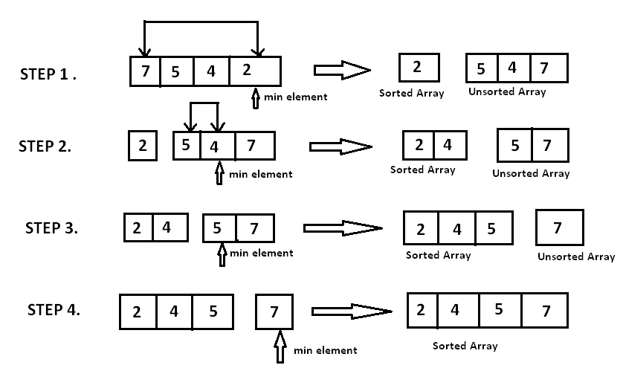
Example: Contd.

Slide 7
Selection Sort: Algorithm
Concept for sort in ascending order:
Locate smallest element in array, exchange it with element in position 0
Locate next smallest element in array, exchange it with element in position 1.
Continue until all elements are arranged in order

Slide 8
Selection Sort: Code
35 void selectionSort(int array[], int size) 36 { 37 int startScan, minIndex, minValue; 38 39 for (startScan = 0; startScan < (size - 1); startScan++) 40 { 41 minIndex = startScan; 42 minValue = array[startScan]; 43 for(int index = startScan + 1; index < size; index++) 44 { 45 if (array[index] < minValue) 46 { 47 minValue = array[index]; 48 minIndex = index; 49 } 50 } 51 array[minIndex] = array[startScan]; 52 array[startScan] = minValue; 53 } 54 }

Slide 9
Bubble Sort
Concept:
Compare 1st two elements
If out of order, exchange them to put in order
Move down one element, compare 2nd and 3rd elements, exchange if necessary. Continue until end of array.
Pass through array again, exchanging as necessary
Repeat until pass made with no exchanges

Slide 10
Bubble Sort: First Pass
Array numlist3 contains:
17 | 23 | 5 | 11
compare values
17 and 23 – in correct
order, so no exchange
compare values 23 and
11 – not in correct order,
so exchange them
compare values 23 and
5 – not in correct order,
so exchange them

Slide 11
Second Pass
After first pass, array numlist3 contains:
17 | 5 | 11 | 23
compare values 17 and
5 – not in correct order,
so exchange them
compare values 17 and
23 – in correct order,
so no exchange
compare values 17 and
11 – not in correct order,
so exchange them

Slide 12
Third Pass
After second pass, array numlist3 contains:
5 | 11 | 17 | 23
compare values 5 and
11 – in correct order,
so no exchange
compare values 17 and
23 – in correct order,
so no exchange
compare values 11 and
17 – in correct order,
so no exchange
No exchanges, so
array is in order

Slide 13
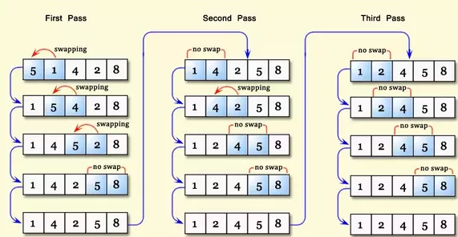
Exercise
5 | 1 | 4 | 2 | 8

Slide 14
Bubble Sort: Algorithm
Idea:
1. Set flag = false
2. Traverse the array and compare pairs of two consecutive elements
1.1 If E1 ≤ E2 -> OK (do nothing)
1.2 If E1 > E2 then Swap(E1, E2) and set flag = true
3. repeat 1. and 2. while flag=true.

Slide 15
Bubble Sort: Code
do {
swp=false;
// different passes
for(j=0 ; j< n-1 ; j++)
{
// swap if incorrect order
if( arr[j]> arr[j+1])
{
temp=arr[j];
arr[j]=arr[j+1];
arr[j+1]=temp;
swp=true;
}
}
} while(swp);

Slide 16
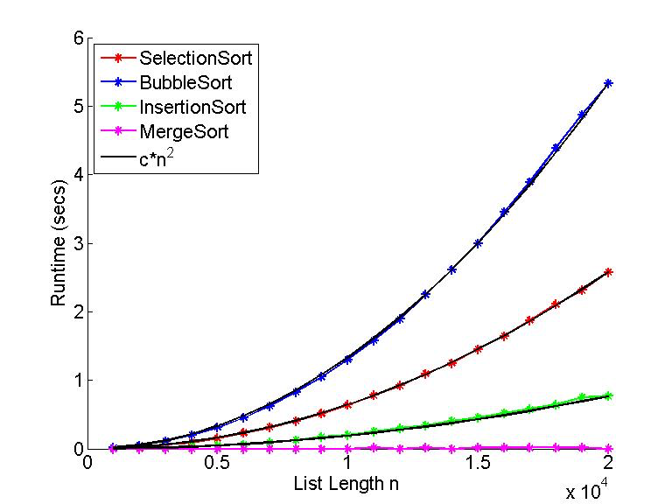
Bubble Sort Vs. Selection Sort
Bubble Sort | Selection Sort
Easy to understand & Implement | More efficient than Bubble Sort, since fewer exchanges
Inefficient: slow for large arrays | May not be as easy as Bubble Sort to understand

Slide 17
Thank You

